Slide 1
Overview BitBang and interface detection

Slide 2
What is BitBang?
A software serial port (UART) for XMC1400 microcontrollers.
Normally a chip has a hardware UART peripheral to send/receive serial data.
BitBang does the same thing purely in software, by switching GPIO pins on and off with precise timing.
Benefit: you can add an extra serial port on any two spare pins, even when no hardware UART is free.
Cost: it keeps the CPU busy while sending/receiving (blocking), and timing must be tuned.

Slide 3
Used Hardware
KIT_XMC14_2GO
User manual: Infineon KIT_XMC14_2GO User Manual (PDF)
→ Must be flashed with the provided firmware before use.
TLI sensor
Connections: 3V3→3V3, GND→GND, Board RX → Sensor TX, Board TX → Sensor RX
LED Indicators (status of the system):
LED | State | Meaning
LED 1 | Blinking | Board is sending the configured signal (working)
LED 2 | Off | Everything works — a valid reply was received
LED 2 | On (solid) | No signal received back from the sensor

Slide 4
Overview
bitbang.c and bitbang.h
Together they form a reusable software-UART library.
The only files required to integrate the library into another project
bitbang.c defines the public API, bitbang.c contains the implementation
main.c and the remaining flies:
Illustrates how to configure and call the library.
Provided for reference, not required for integration.

Slide 5
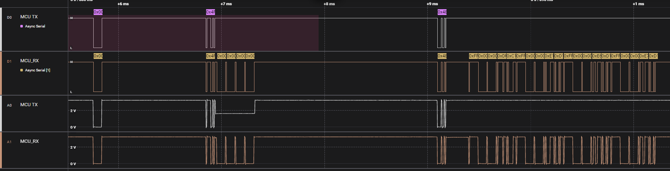
Example of the logic analyzer
The image shows the logic analyzer capture that originates from the bit-bang main.c which also includes the start up routine marked in light red.

Slide 6
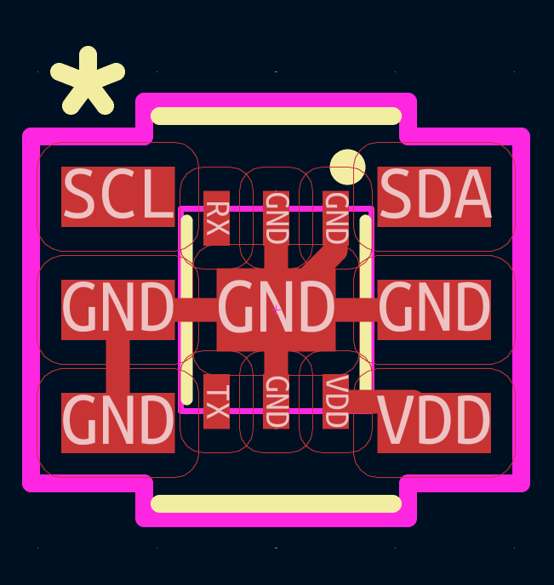
How to probe if the connected sensor is UART/DART or I2C if pads are shared
Connect the I2C_SCL and UART_MCU_TX (Sensor_RX) from now on called A
Connect the I2C_SDA and UART_MCU_RX (Sensor_TX) from now on called B
In order to detect what type of sensor is populated, configure A as push-pull high; and B as input with internal pull-up.
Send on A a low pulse e.g. 4 µs low time and monitor on B if the voltage follows. If testing with multiple low pulses, maintain a break of min 400 µs between pulses. (timeout)
If B follows the pulse behavior of A, a UART/DART sensor is connected.
If B does not follow the pulse behavior of A, try sending a I2C command on the expected addresses and evaluate if the I2C commands get acknowledged.

